Slide 1




WISENET
W i r e l e s s S e n s o r N e t w o r k
WISENET
24-04-2014
Ch.Udhay
18311A05R4
CSE-E

Slide 2





Overview
Introduction
Design Goals
System Description
Software Components
Hardware Design
Power consumption
Applications
Future Scope
Conclusion

Slide 3
Introduction
What is Wisenet?
Wireless sensor network is a network of devices that can communicate the information gathered from a monitored field through wireless links. The data is forwarded through multiple nodes, and with a gateway, the data is connected to other networks & it monitors environmental conditions.
What is “Motes”?
Mote is a node in a sensor network that is capable of performing some processing, gathering sensory information and communicating with other connected nodes in the network.

Slide 4
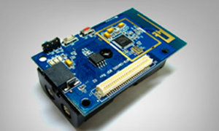
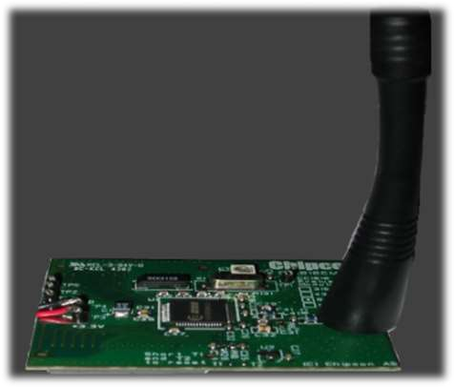
Sensor motes

Slide 5
How does Wisenet work?
The server stores the data in a database where it can later be retrieved and analysed via a web based interface.
The network works successfully with an implementation of sensor mote.

Slide 6
Why we need Wisenet ?
Smart environment represent the next evolutionary development step in building, utilities, industrial, home, shipboard, and transportation systems automation.
They may work in interior of a large machinery, at the bottom of an ocean, inside a twister, in a battlefield, in a home, in large building, or be attached to animals

Slide 7
System Description
There are two subsystems
Primary subsystems
Data Analysis
Data Acquisition
System Components
Client
Server
Sensor Mote Network

Slide 8

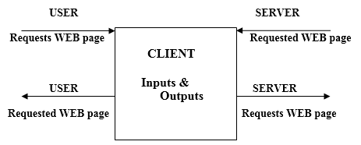
System Description
System Components
Client
Standard Web browser via Internet
Any computer with a web browser and internet access could be a
client. It served only as a user interface to the Data Analysis subsystem.

Slide 9

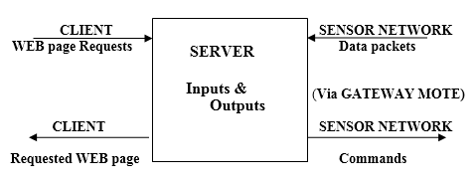
System Components
2. Server
Web Program Flow

Slide 10
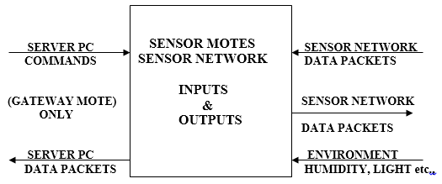

System Components
3. Sensor Motes
It is the component responsible for collecting raw environmental data and transmitting that data to the Server.

Slide 11

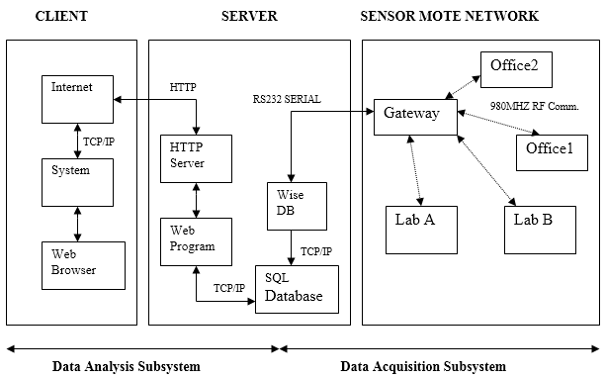
System Description
System Block diagram

Slide 12
Software Components
WISENET is also composed of three custom software components
Web program
WiseDB
TinyOS

Slide 13
Hardware Design
Optimized 8051-core
Active (14.8 mA), Idle (29 A) and sleep (0.2 A) power modes
32 kB flash memory
2 kB +128 bytes SRAM
Hardware DES encryption/decryption
Hardware random bit-generator

Slide 14
Applications
Lab / Office Monitoring
Habitat Monitoring
Security Applications
Extreme Weather Surveillance
Potential Biomedical Applications
Military Reconnaissance

Slide 15
Future Work
Expand network to develop & test multi-hop routing
Develop a single-board mote
Create a expandable, plug-in sensor interface
Research alternative energy sources
solar cell, rechargeable batteries
Continue development of TinyOs
Improve tools
Optimize performance/reduce power usage
Improve web interface

Slide 16
Power consumption
Sensor node lifetime shows a strong dependence on battery lifetime
Power consumption can be divided into:
–Sensing
–Communication
–Processing

Slide 17
Conclusion
WISNET is smaller and faster
Low-power
Open-source software
Modular mote application design(TinyOS)
Flexible server implementation
Simple user interface via the web

Slide 18
THANKS

